Slide 1


AIR PASSENGER RIGHTS UNDER LAW
COMPENSATION & CLAIMS
MECHANISMS FOR AIR PASSENGERS
Presented by
Mr. Kehinde Ojuawo,
Partner, Banwo &Ighodalo
March 12, 2026

Slide 2

01. INTRODUCTION

Slide 3



INTRODUCTION
CHAPTER 1
INTRODUCTION
Air passengers/ consignors occupy a structurally weaker position, relative to airline operators (who control pricing, scheduling, safety decisions and general terms of the carriage), who typically use standard-form tickets to regulate the contractual relationship, with minimal or no room for negotiations. Therefore, mandatory compensation frameworks serve to provide a mechanism for redress for customers, while taking into consideration and balancing the need to preserve the sustainability of the aviation industry and maintaining a fair relationship between both parties.
Compensation regimes seek to ensure protection of consumer interests (through the equitable principle of restitution and strict liability for carriers), while affirming the sustainability of international air transport operations.
Objectives of Compensation Frameworks
Establishing a uniform (and, where feasible, universal) legal framework for air carrier liability;
Ensuring protection for passengers in cases of delay, damage, loss, or injury;
Reinforcing consumer confidence through regulatory discipline; and
Ensuring clarity and consistency in liability claims and compensation regimes; thereby engendering and providing for a fair and efficient compensation mechanism.

Slide 4
02. LEGAL FRAMEWORK

Slide 5

CHAPTER 2
LEGAL FRAMEWORK
LEGAL FRAMEWORK
The Montreal Convention, 1999
Nigeria Civil Aviation Act, 2022
Nigeria Civil Aviation Regulations 2023 – (Part 19 – Customer Protection)
Case Law / Judicial Decisions
.

Slide 6
03. MONTREAL CONVENITON

Slide 7
THE MONTREAL CONVENTION
The Convention for the Unification of Certain Rules for International Carriage by Air, 1999 (“Montreal Convention”), establishes a uniform legal framework governing the liability of air carriers and compensation of customers in international carriage. The Montreal Convention applies to international flights between State Parties or within a State Party but with a stop in another State; and seeks to establish uniform rules across the jurisdictions of the State Parties. It regulates all international carriage of persons, baggage or cargo performed by aircraft for reward, as well as gratuitous carriage by aircraft performed by air transport undertakings. Nigeria is a signatory to the Convention; and it has been domesticated under our local laws.
The Convention (particularly Chapter III thereunder) establishes the framework for airline liability and extent of compensation in cases of:
Carriage of Persons, for – (a) death or bodily injury or passenger (Article 17(1) of the Convention); and (b) loss or damage of baggage – both (i) checked and (ii) unchecked/ personal baggage – of passengers (Article 17(2) of the Convention); and
Carriage of Cargo, for damage to cargo (Article 18 of the Convention);
capping compensation for liability at limits set in the Convention (unless exceptions apply). The limits are reviewed by the International Civil Aviation Organization (“ICAO”) at 5-year intervals, including adjustments for inflation/ consumer price indices (Article 24 of the Convention) .
Compensation under the Convention is calculated on the basis of/ indexed to Special Drawing Rights (“SDRs”), which are an international reserve matrix created by the International Monetary Fund (“IMF”) and used as a standardized unit of account in international agreements. SDR is an international reserve asset created by the IMF to supplement the official reserves of its member countries. The SDR is not a currency. It is a potential claim on the freely usable currencies of IMF members. Their value is determined based on a number of major currencies namely the US Dollar, Euro, Chinese Yuan, Japanese Yen, and British Pound, which makes them a neutral valuation unit in international legal frameworks. In practice, amounts expressed in SDRs are converted into the relevant local currency at the applicable exchange rate on the date of judgment or payment. – Article 23 of the Convention.

Slide 8
CHAPTER 2
THE MONTREAL CONVENTION
1 SDR | = | US$1.37
Compensation Limits under Articles 17, 18, 21 and 22 of the Montreal Convention
Nature of Liability | Original Montreal Convention SDR Points | Revised SDR Points (from December 28, 2019) | Revised SDR Points (from December 28, 2024)
Death or bodily injury Articles 17(1) and 21 | Not exceeding 100,000 | Not exceeding 128,821 | Not exceeding 151,880
Damage to Baggage and Cargo, caused by Delay Articles 19 and 22(1) | Not exceeding 4,150 | Not exceeding 5,346 | Not exceeding 6,303
Damage caused to Baggage (without special declaration by Passenger) Articles 17 and 22(2) | Not exceeding 1,000 | Not exceeding 1,288 | Not exceeding 1,519
Damage caused to Cargo(without special declaration by Consignor) Articles 18 and 22(3) | 17 per kilogramme | 22 per kilogramme | 26 per kilogramme
151,880
The liability limits above shall not apply where – (1) death, bodily injury, loss, damage, or delay results from an act or omission of the carrier or its servants or agents committed intentionally, or recklessly with knowledge that such damage would likely occur; and (2) where there is special declaration by the Passenger/ Consignor. In such instance, the passenger is entitled to claim above the prescribed limits.

Slide 9
CHAPTER 2
CLAIMS AND COMPENSATION UNDER THE MONTREAL CONVENTION
Article 17(1) of the Convention provides, in respect of carriage of passengers that a carrier is liable for damage sustained in the event of the death or bodily injury of a passenger, provided that the accident which caused the death or injury occurred onboard the aircraft or in the course of the operations of embarking or disembarking.
The air carrier is liable for damages sustained in case of death or bodily injury of a passenger if the aviation accident causing the injury occurred on board the aircraft or during embarkation or disembarkation. For a claim to succeed under the Montreal Convention, there must first be an aviation accident. An accident under the Montreal Convention has been defined as an unexpected or unusual event external to the passenger. Courts have consistently held that a health-related or natural condition such as a heart attack caused purely by internal medical issues does not qualify as an "accident" under Article 17(1) of the Convention.
If, however, the injury, loss or damage can be shown to have been triggered or worsened by an external aviation-related event (e.g., crew failure to respond, lack of basic medical equipment, or delay in emergency landing), then a claim under the Convention may succeed. This was restated in the case of Air France v. Saks (U.S. Supreme Court), Anibaba v. Dana Airlines Ltd (Nigeria’s Supreme Court), and Safa v. Lufthansa (UAE Courts),
In Krys v. Lufthansa German Airlines, a passenger suffered a heart attack on a trans-atlantic flight from Miami to Frankfurt and sued Lufthansa for damages, arguing that the airline worsened his condition by failing to divert the aircraft so he could receive immediate medical treatment. The Court held that the heart attack was not caused by an unusual or unexpected external event and therefore did not amount to an “accident”. However, the airline was found negligent for failing to follow procedures and divert the flight despite signs of a heart attack, and damages of $2.4 million were upheld ($1.8 million to Krys and $600,000 to his wife).

Slide 10
CLAIMS AND COMPENSATION UNDER THE MONTREAL CONVENTION
Article 17(1) of the Montreal Convention applies to accidents that occur during the operations of embarking or disembarking. However, the Convention does not define these terms, making it difficult to determine exactly when embarking begins or disembarking ends. Courts therefore assess the issue based on several factors, including the passenger’s activity at the time of the injury, any restrictions on the passenger’s movement, the proximity to boarding, and the passenger’s physical closeness to the departure gate.
In Walsh v. Koninklijke Luchtvaart Maatschappij N.V., the Court held that a passenger who tripped near the departure gate was already embarking because he was approaching the boarding area. Similarly, courts have held that a passenger may still be disembarking even after leaving the aircraft if they remain under the airline’s direction, such as when moving through the airport toward immigration. Ultimately, courts determine whether embarking or disembarking has occurred based on the specific facts and circumstances of each case.
In Harkar Air Services v. Keazor, the Plaintiff was injured when a Harkar Air flight from Kaduna to Lagos crash-landed after flying in bad weather. He brought an action against the airline for personal injury and loss of baggage. The Court applied the provisions of the Montreal Convention and held that the carrier was liable for the injuries sustained during the flight. The Supreme Court of Nigeria affirmed that where the damage results from the willful misconduct of the carrier or its employees, the Convention still applies, but the airline can rely on the limitation of liability provided under the Convention.

Slide 11
CLAIMS OUTSIDE THE MONTREAL CONVENTION
CHAPTER 2
Claims for emotional distress, psychological injury grief, or moral damages are generally not recoverable under the Convention.
    In Eastern Airlines v Floyd an aircraft flying from Florida to the Bahamas lost power in all three of its engines. The crew having notified the passengers that a crash landing into the sea was imminent awaited their fate. Fortunately, the crash was averted when, at the last moment one, of the engines was re-started. However, a number of passengers subsequently brought claims against the carrier seeking damages for the emotional distress they suffered. Their claims were dismissed. There being no question of the passengers suffering any physical injury, the Court had to determine only whether a ‘mental or psychic injury’, fell within the terms of a ‘bodily injury’. In the UK, the House of Lords decision of Morris v KLM Royal Dutch Airlines addressed the issue of whether a 16 year old girl could recover damages under Article 17 for clinical depression suffered after another passenger sexually assaulted her aboard a flight from Kuala Lumpur to Amsterdam. It was concluded that Article 17 does not allow a person to recover for emotional damage.
Death or injury resulting from natural illness, underlying medical conditions, or internal reactions of the passenger is generally not compensable unless it can be shown that an air carriage accident contributed to or triggered the condition.
Damage caused solely by the act or omission of a third party, which the airline could not reasonably prevent, may fall outside the carrier’s liability. In Ford v Malaysian Airlines System Berhard it was held that the administration of an injection by a medically qualified person to treat another passenger, which seemed to worsen the passenger’s condition rather than improve it, was not an accident.
Where the injury results entirely from the passenger’s own conduct, the carrier may avoid liability.
In Singh v Caribbean Airlines Limited, it was held that as long as the Crew did not depart from the policies and procedures of the airline in responding to a medically ill passenger, such situation cannot be regarded as an accident, despite the adverse consequences. In Safa v Lufthansa, the crew’s response to an immediate medical issue largely followed the airline’s policies and procedures, and again the Court held that this could not be deemed an accident.

Slide 12
TREATMENT OF BAGGAGE LOSS UNDER THE MONTREAL CONVENTION
Article 17(2) of the Convention provides that the Carrier is liable for damage sustained in the event of the destruction of, loss of, or damage to both (1) checked baggage; and (2) unchecked baggage, on the condition that:
In the case od checked baggage, the destruction, loss, or damage occurred onboard the aircraft or during any period in which the checked baggage was in the charge of the carrier; or
In the case of unchecked baggage, including personal items carried on board, where the damage resulted from the fault of the carrier or that of its servants or agents.
However, the Carrier shall not be liable if, and to the extent that, the damage resulted from the inherent defect, quality, or vice of the baggage.
A Bag shall be deemed lost where:
The Carrier admits the loss of the checked baggage; or
The checked baggage has not arrived within twenty-one (21) days after the date on which it ought to have arrived.
In the above circumstances, the passenger shall be entitled to enforce the rights and remedies available under the Convention.

Slide 13
THE MONTREAL CONVENTION
TREATMENT OF DESTRUCTION, LOSS OF, OR DAMAGE TO CARGO UNDER THE MONTREAL CONVENTION
Article 18 of the Convention provides that a carrier is liable for damage sustained in the event of the destruction or loss of, or damage to, cargo upon condition only that the event which caused the damage so sustained took place during the carriage by air.
Article 18(2) however provides that the carrier is not liable if and to the extent it proves that the destruction, or loss of, or damage to, the cargo resulted from one or more of the following:
(a) inherent defect, quality or vice of that cargo;
(b) defective packing of that cargo performed by a person other than the carrier or its servants or agents;
(c) an act of war or an armed conflict;
(d) an act of public authority carried out in connection with the entry, exit or transit of the cargo.
TREATMENT OF DELAYS UNDER THE MONTREAL CONVENTION
Article 19 of the Convention provides that a carrier is liable for damage occasioned by delay in the carriage by air of passengers, baggage or cargo. Nevertheless, the carrier shall not be liable for damage occasioned by delay if it proves that it and its servants and agents took all measures that could reasonably be required to avoid the damage or that it was impossible for it or them to take such measures.

Slide 14
THE MONTREAL CONVENTION
EXONERATION OF CARRIER
Article 20 of the Convention provides that if the carrier proves that damage was caused or contributed to by the negligence or other wrongful act or omission of the person claiming compensation, or the person from whom he or she derives his or her rights, the carrier shall be wholly or partly exonerated from its liability to the claimant to the extent that such negligence or wrongful act or omission caused or contributed to the damage.
When by reason of death or injury of a passenger compensation is claimed by a person other than the passenger, the carrier shall likewise be wholly or partly exonerated from its liability to the extent that it proves that the damage was caused or contributed to by the negligence or other wrongful act or omission of that passenger.
OTHER MATTERS
Under the Convention, airline liability generally operates as a form of strict liability, meaning the air carrier is presumed responsible for passenger injury unless it can prove that the damage was not caused by an accident attributable to the carrier. The purpose is to reduce lengthy litigation, particularly over the amount of damages, and to ensure clarity and certainty regarding airline liability.
If the Convention does not apply, a claimant may pursue domestic claims in tort or negligence, but liability must then be proven in court and compensation is not automatic, as it depends on what can be established through evidence.

Slide 15
THE MONTREAL CONVENTION
According to Article 29 of the Convention, in cases involving the carriage of passengers, baggage, or cargo, any action for damages whether based on the Convention, contract, tort, or otherwise—must be brought subject to the conditions and limits of liability set out in the Convention, and punitive or exemplary damages are not recoverable.
Under Article 33 of the Convention, a claim for damages may be brought, at the claimant’s choice, before the courts of the air carrier’s principal place of business, the place where the contract of carriage was made, or the place of destination. In cases involving the death or injury of a passenger, the claim may also be brought in the State where the passenger had their principal and permanent residence at the time of the accident, provided the carrier operates passenger services to or from that State and conducts business there.
The right to damages shall be extinguished if an action is not brought within a period of two years, reckoned from the date of arrival at the destination, or from the date on which the aircraft ought to have arrived, or from the date on which the carriage stopped. The modalities for calculating that reference period shall be determined by the law of the court seised of the case (Article 35 of the Convention).
  Article 25 of the Convention permits a carrier may stipulate that the contract of carriage shall be subject to higher limits of liability than those provided for in this Convention or to no limits of liability whatsoever!!
  Article 26 of the Convention provides that any contractual provision that attempts to relieve the carrier of liability or set a lower limit of liability than that provided in the Convention is considered null and void. However, this does not invalidate the entire contract of carriage, which will still remain subject to the provisions of the Convention (Article 47 of the Convention).
  Similarly, any clause in a contract of carriage or special agreement made before the damage occurred that seeks to override the rules of the Convention such as by choosing a different applicable law or altering the jurisdiction rules will also be invalid and unenforceable.

Slide 16
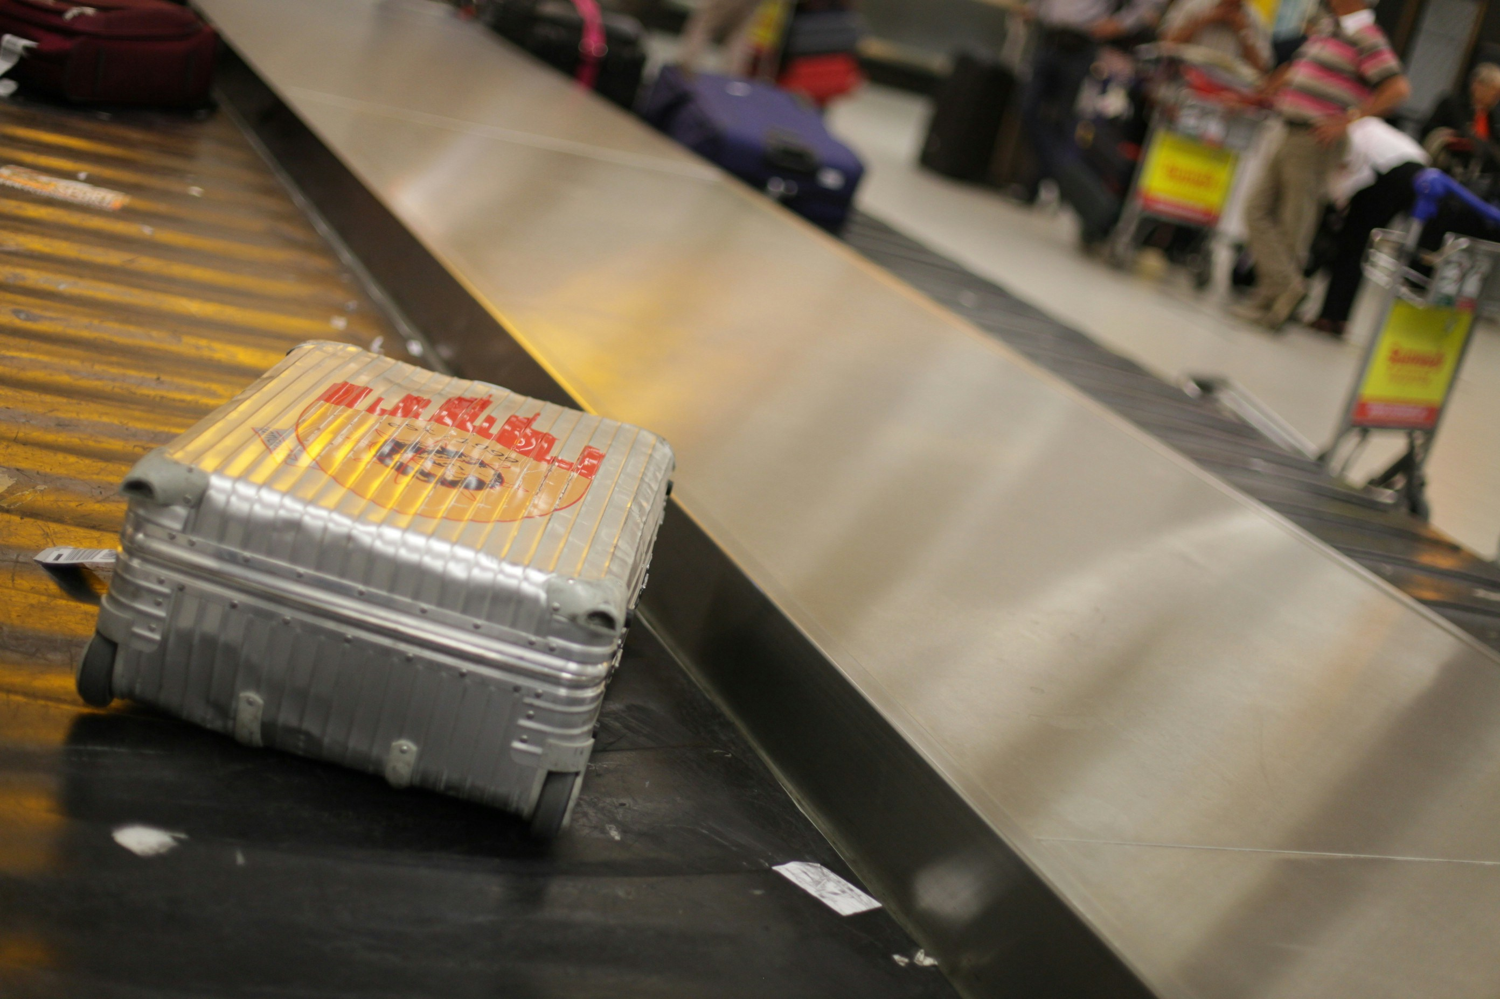
THE MONTREAL CONVENTION
The liability of the Airline in the case of destruction, loss, damage, or delay of baggage is limited to 1,000 SDRs per passenger. However, this limitation shall not apply where:
The Passenger, at the time the checked baggage was handed over to the Carrier, made a special declaration of interest such as declaration of the value of the baggage; or
The Passenger paid any supplementary sum required by the Carrier based on such declaration, such as obtaining insurance coverage for a value exceeding the applicable limit.
In such circumstances:
The Carrier shall be liable to pay a sum not exceeding the declared amount; and
The Carrier may avoid liability for the full declared amount if it proves that the declared sum exceeds the passenger’s actual interest in delivery at the destination.
.

Slide 17

Cameroon Airlines v. Abdulkareem (2003) 11 NWLR (Pt. 830) 1
THE MONTREAL CONVENTION
Also, the above limits will not apply where it is proved that the damage resulted from an act or omission of the Carrier, its servants or agents, done with intent to cause damage or recklessly and with knowledge that damage would probably result provided that, in the case of such act or omission of a servant or agent, it is also proved that such servant or agent was acting within the scope of its employment. However, this will typically require adducing such proofs in litigation.

Slide 18
Cameroon Airlines v. Abdulkareem (2003) 11 NWLR (Pt. 830) 1
THE MONTREAL CONVENTION
CASE LAW
Cameroon Airlines v. Abdulkareem - The Respondent, a Lagos-based fashion trader, travelled on the Appellant’s flight from Jeddah to Lagos with three checked-in bags, containing clothing and accessories, for which she paid excess luggage charges. Upon arrival in Lagos, the three bags were missing and could not be traced by the airline. She sued the airline at the Federal High Court, Lagos, claiming ₦4 million in damages for the lost luggage and its contents. The trial court awarded ₦3 million in damages, holding that the claim did not fall within the scope of the Convention. However, the Court of Appeal held that the claim for the loss of baggage during an international flight fell exclusively within the Convention, and not under common law. Consequently, the trial court erred by awarding damages outside the limits prescribed by the Convention. The Court further held that the passenger did not prove a valid declaration of value or payment of a supplementary charge as required under the Convention to avoid the limitation of liability. Additionally, there was no evidence of willful misconduct by the airline (under Article 25), which could have removed the liability limit. As a result, the award of ₦3 million damages was set aside, and the passenger’s claim was dismissed.

Slide 19
THE MONTREAL CONVENTION
CASE LAW
In Emirates Airline v. Aforka, the Respondents contracted the Appellant airline to airfreight 18 bags of ink cartridges (880 kg) from Dubai to Lagos, but the cargo was never delivered. The trial court held the airline liable for breach of contract and awarded 29,319 UAE Dirham and ₦5 million in general damages. On appeal, the Court of Appeal held that the contract was governed by the Montreal Convention, which limits the liability of air carriers for cargo loss to 17 Special Drawing Rights (SDR) per kilogram unless a special declaration of value is made. Since no valid declaration of value was submitted, the airline’s liability was limited under the Convention. The Appellate Court therefore set aside the trial court’s award of ₦5 million in general damages and held that the Respondents were only entitled to compensation calculated under the Montreal Convention, plus a refund of freight charges.

Slide 20
Cameroon Airlines v. Abdulkareem (2003) 11 NWLR (Pt. 830) 1
THE MONTREAL CONVENTION
CASE LAW
In British Airways v. Atoyebi, the Respondent traveled first class on a British Airways flight from London Heathrow to Lagos Murtala Muhammed International Airport on 8 May 2000. Upon arrival, one of his hand luggage items, which had been properly tagged and checked in, did not arrive. Despite being informed that the bag had been located at Heathrow and would be sent to Lagos, the bag was not delivered. The Respondent visited the Lagos airport twice daily between 8 and 10 May,2000, but the luggage never arrived. When he instructed an associate in London to collect it, the airline refused. Consequently, on 10 May, the Respondent returned to London on a business class ticket to retrieve the bag personally, finding it intact among other bags at the airline’s facility. The Respondent sued British Airways for the inconvenience and losses suffered, rejecting the airline’s offer of £508.48 in compensation. The Supreme Court held the Convention governs baggage claims. The airline’s refusal to release the bag and misleading conduct amounted to willful misconduct, removing liability limits. Special damages for actual losses were upheld, but £100,000 general damages for stress were set aside as excessive.

Slide 21
03. NIGERIAN LAW

Slide 22

Nigeria Civil Aviation Act, 2022
The Nigeria Civil Aviation Act 2022 (the “NCAA Act”), incorporates and domesticates the Montreal Convention (in Section 55) in respect of international and non-international carriage by air. Thus, the NCAA Act governs the rights and liability of air carriers, passengers, consignors, consignees and other persons.
In Mekwunye v. Emirates Airlines, the Court stated the provisions of the Montreal Convention should be interpreted in a way that fulfils its purpose, which is to provide better protection and compensation for passengers and consumers, while also facilitating efficient air transport.
In Anibaba v. Dana Airlines Ltd., the Supreme Court of Nigeria stated that the Montreal Convention establishes a comprehensive legal framework governing the rights and liabilities of air carriers, passengers, and third parties. The Court explained that the Convention was adopted to modernise and harmonise the liability regime for international air carriage. Its main objective is to create a uniform legal system that balances the interests of both passengers and airlines, ensures predictability and consistency in liability claims, and provides a fair and efficient compensation system for passengers and their dependants.

Slide 23
Compensation under the Nigeria Civil Aviation Act, 2022
Section 50 – confirms application of the Montreal Convention
Section 55(3) of the NCAA Act provides that: “In any case of aircraft accident resulting in death or injury of passengers, the airline operator or carrier shall make advance payments of Naira equivalent of at least 30,000 United States Dollars within 30 days from the date of such accident, to the natural person or such natural persons who are entitled to claim compensation in order to meet the immediate economic needs of such persons and such advance payments shall not constitute recognition of liability and may be offset against any amount subsequently paid as damages by the carrier.” (Strict liability)

Slide 24
Compensation under the Nigeria Civil Aviation Act, 2022
In Anibaba v. Dana Airlines Ltd (2025), the Nigerian Supreme Court clarified the legal position on claims and compensation arising from air carriage under the Convention. The Supreme Court held that:
“By virtue of the Nigerian Civil Aviation Act, the Convention applies to both international and domestic carriage by air. Given the comprehensive nature of the liability regime established by the Convention as domesticated in Nigeria, it operates as the exclusive framework for addressing claims arising from carriage by air. Accordingly, claims for damages in Nigeria arising from the death of a passenger during carriage by air must be brought solely under the Montreal Convention as domesticated, subject to its conditions and limits. A passenger is not at liberty to choose between the provisions of the Convention and domestic or common law in pursuing claims for damages against the carrier. Such claims must be asserted only in accordance with, and subject to, the terms and conditions of the Convention and cannot be pursued under any other law.”

Slide 25
Cameroon Airlines v. Abdulkareem (2003) 11 NWLR (Pt. 830) 1
RIGHTS FOR LOSS OF BAGGAGE UNDER NIGERIAN LAW
Article 19.18 of the Nigerian Civil Aviation Regulations 2023 provides that a passenger shall have the right to his/her baggage carried on the same flight that such passenger takes, subject to the considerations of safety, security, or any other legal and valid cause. However
If checked baggage is off-loaded for operational, safety, or security reasons, the Airline must promptly notify the passenger. Off-loaded baggage must be carried on the next available flight, with immediate compensation for inconvenience: ₦10,000 for domestic and $170 for international flights.
Baggage is presumed permanently lost if not delivered within 7 days (domestic) or 21 days (international). Refunds of baggage fees apply if baggage is not delivered within 24 hours of flight arrival. Compensation for loss or damage generally follows the Convention.

Slide 26
Entitlements under the Nigeria Civil Aviation Regulations – Part 19 (Customer Protection)
S/N | Rights/Obligations | Compensation
1. | Overbooked Flight | When a flight is oversold, the airline must first ask passengers to volunteer to give up their seats with compensation. Only if enough volunteers are not found can the airline involuntarily deny boarding based on its boarding priority rules. If not enough passengers volunteer, the airline may deny boarding to some passengers involuntarily according to its boarding priority rules. If a passenger is involuntarily denied boarding, the airline must immediately compensate the passenger and provide assistance.
2. | Boarding Priority Rules | Every airline must have clear boarding priority procedures to decide persons who will be (preferentially) granted boarding and those who will be denied boarding (if necessary). These rules must be fair and understandable to passengers to avoid unfair discrimination or unreasonable preference. The Airline may determine priority by: Urgent medical travel Time of check-in Whether the passenger already has a seat assignment Fare paid Frequent flyer status Passengers with reduced mobility or unaccompanied minors Families with young children (5 years or younger)
3. | Flight Change | When an airline makes a significant change to a flight, the airline shall provide the passengers with notice of the change not later than 12 hours before the scheduled time of departure (for domestic flights) and not later than 14 days before the date of departure (for international flights) and the assistance specified and reimbursement or rerouting as applicable.

Slide 27
Nigeria Civil Aviation Regulations – Part 19 Customer Protection
S/N | Rights/Obligations | Compensation
3. | Delayed Flights | If a Domestic Flight is delayed: Within 30 minutes: The airline must inform passengers of the reason for the delay, within 30 minutes after the scheduled departure time. After 2 hours: Passengers are entitled to receive refreshments and make up to two phone calls, send SMS, or emails. After 3 hours: Passengers must be offered either a full ticket refund or an alternative flight. Delays between 10:00 PM and 4:00 AM, or if the airport is closed: The airline must provide hotel accommodation and transport to and from the hotel. After 6 hours: Passengers are entitled to compensation. However, airlines are not required to pay compensation if the delay was caused by extraordinary circumstances beyond their control. If an International Flight is delayed: Delay of 2–4 hours: Passengers are entitled to compensation and assistance for making phone calls, sending SMS, or emails. Delay of more than 4 hours: Passengers are entitled to meals and communication assistance. Expected delay of 6 hours or more: Passengers are entitled to hotel accommodation and transport to and from the hotel. Compensation is: 25% of the fares or passenger ticket price for (Domestic Flights); and 30% of the passenger ticket price (for international flights).
CHAPTER 2

Slide 28
Nigeria Civil Aviation Regulations – Part 19 Customer Protection
S/N | Rights/Obligations | Compensation
4. | Tarmac Delay | If a flight is delayed on the tarmac after the aircraft doors are closed for take-off or after landing, the air carrier shall provide: Information updates: Provide passengers with the reason for the delay and status updates every 30 minutes. Basic facilities: Ensure access to lavatories and adequate ventilation or cooling. Food and drink: Provide food and beverages in reasonable quantities no later than 2 hours after the start of the tarmac delay. Disembarkation: Offer passengers the opportunity to disembark before the tarmac delay exceeds three hours. Contingency plan: Maintain and adhere to a Contingency Plan for lengthy tarmac delays for flights at each airport where it operates or markets air service. Reporting: Submit a completed mandatory tarmac delay report to the relevant Authority. For domestic flights, the report is required after two hours; for international flights, after three hours.
5. | Cancellation | If a flight is cancelled, the passengers are entitled to receive: Assistance and care: Meals, communication support (phone calls, SMS, emails), and hotel accommodation, full refund or rebooking on an alternative flight. Compensation: Passengers are entitled to compensation unless: For domestic flights, they were informed at least 24 hours before departure; or For international flights, they were informed at least 7 days before departure. Limitations: Airlines are not liable for cancellations caused by extraordinary circumstances beyond their control
CHAPTER 2

Slide 29
04. COMPLAINT AND CLAIMS

Slide 30


CHAPTER 6
CLAIMS & ENFORCEMENT
COMPLAINTS AND CLAIMS PROCESS
Report to Airline
Escalate to NCAA
NCAA Investigation
Under Article 19.24.1.1, every Airline is required to have a designated officer for receiving and resolving complaints.
A Passenger may subsequently make a complaint with the NCAA after the consumer must have notified the air carrier and the complaint remains unresolved.
Upon receiving a formal Complaint Form (available online and at all airports), the NCAA may investigate, request responses from the airline, and determine whether there has been a violation.
I will also recommend that you speak to a Lawyer, particularly where there is no resolution with the Airline and/or NCAA.

Slide 31

CHAPTER 6
CLAIMS & ENFORCEMENT
JURISDICTION IN NIGERIA
Section 251(K) of the Nigerian Constitution does not exclude claims predicated on non-carriage or late performance of contract of carriage by air. It also provided no exception to the exclusivity of the jurisdiction of the Federal High Court. Rather, Section 7(1) of the Federal High Court (Amendment) Act, No. 60 of 1991, provides that the Court shall, to the exclusion of any other court, have original jurisdiction to try civil causes and matters connected with or pertaining to aviation; safety of aircraft and carriage of passengers and good by air and meteorology.
In KLM Airline v Kumuji, it was clarified that the combined understanding of the provisions of the Federal High Court Act 1973, as amended by Decree No. 60 of 1991, was to oust the jurisdiction of the State High Court, in matters covered under Section 251 (1) (k) of the Constitution; and aimed at increasing the scope of the jurisdiction of the Federal High Court in respect of the subject matter specified there.

Slide 32
07. DEFENCES & ENFORCEMENT CHALLENGES

Slide 33




DEFENCES
CHAPTER 7
Circumstances outside the Convention
Force Majeure
Contributory Negligence
Act of Third Parties

Slide 34
CHAPTER 7
DEFENCES & ENFORCEMENT CHALLENGES
ENFORCEMENT CHALLENGES
Cross-border Enforcement:
Due to differences in interpretation of the Convention’s provisions and factual assessments by courts, which may lead to divergent judgments.
Investigation Capacity:
There may be a struggle to investigate the incident, injury or loss and enforce compliance effectively.
Airline Insolvency:
Passengers may be unable to recover compensation when carriers become insolvent.
Passenger Awareness Gaps:
Many passengers remain unaware of their rights and available remedies.

Slide 35
08. COMPLIANCE STRATEGIES

Slide 36
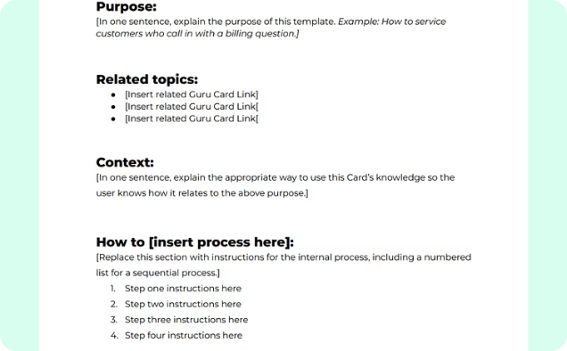


CHAPTER 8
COMPLIANCE STRATEGIES
COMPLIANCE STRATEGIES FOR AIRLINES
Clear Internal SOPs
Automated Notification Systems
Staff Training
Under Articles 8.10.1.9 and 8.10.1.10 of the NCAA Regulations, operational personnel must be formally trained in operational policies and initial dangerous goods training approved by the NCAA before proceeding on a flight. Seating arrangements, passenger briefings, emergency situations, flight plans, and other clear standards must be strictly complied with.
Article 19.21 provides for the Right to Information. Passengers are entitled to full, fair, and clear disclosure of all terms and conditions before making payment. Automated passenger notification systems support compliance by ensuring timely communication of fare details, contractual terms, and relevant updates relating to flight disruptions or changes.
Article 19 of the NCAA Regulations imposes obligations on airlines in relation to delays, cancellations, denied boarding, refunds, and complaint resolution. Compliance requires that operational airline staff be adequately trained to understand and implement passenger rights provisions.

Slide 37
09. CASE STUDIES

Slide 38

CASE STUDIES
Practical Case Scenarios
Sidhu v British Airways Plc.
Passengers on British Airways from London to Kuala Lumpur stopped in Kuwait for refuelling, shortly after Iraq invaded Kuwait. Iraqi forces detained the passengers and crew for several weeks. Many passengers suffered psychological trauma and, in some cases, physical injuries. The passengers brought claims against British Airways.
Does the Claim fall Article 17 of the Convention?

Slide 39
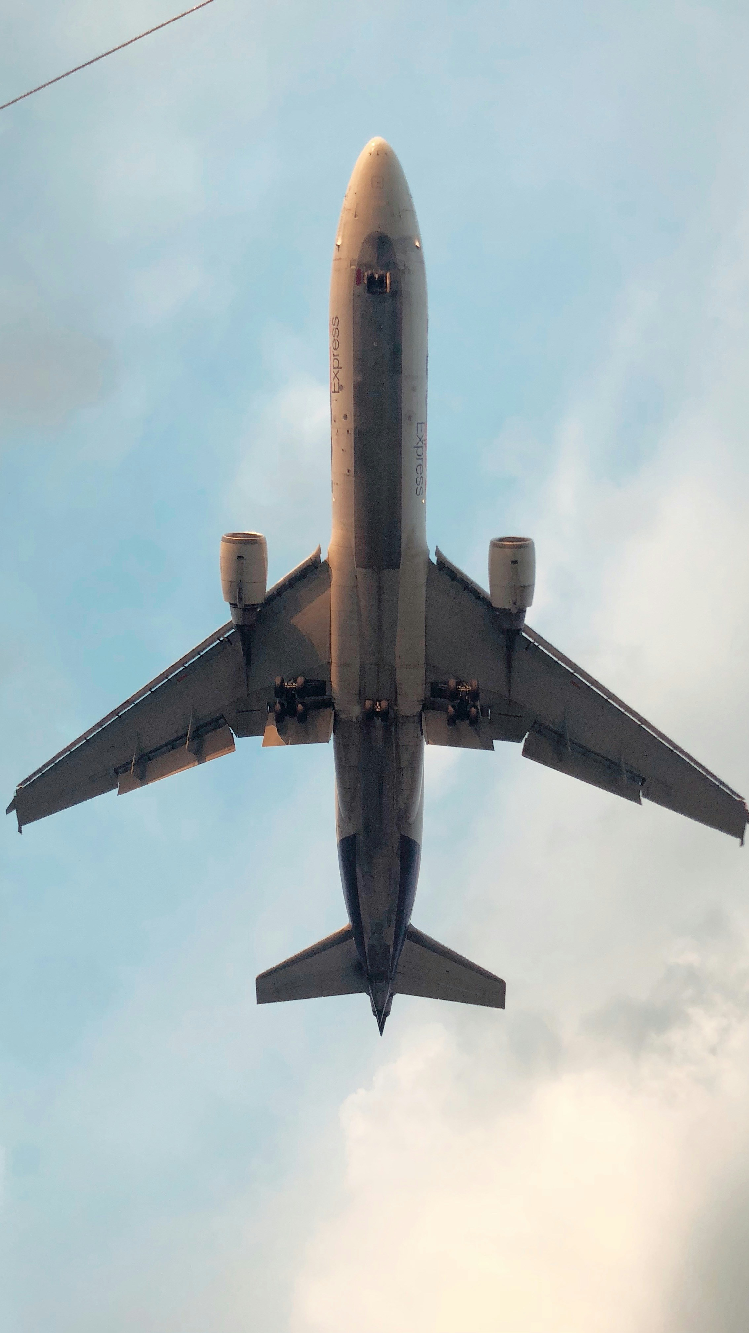
CHAPTER 9
Case Study
Does the Claim fall Article 17 of the Convention?
The claim does not fall within Article 17 of the Montreal Convention, because there was no “accident” occurring on board the aircraft or during embarking or disembarking. The Convention establishes a uniform international framework regulating airline liability. Allowing domestic law claims would undermine the consistency intended by the treaty.
While the answer may not be desirable, the Convention was not designed to provide remedies against the Carrier to enable all losses to be compensated. It was designed instead to define those situations in which compensation was to be available. So, it set out the limits of liability and the conditions under which claims to establish that liability, if disputed, were to be made. A balance was struck, in the interests of certainty and uniformity.

Slide 40

10. CONCLUSION

Slide 41




The landscape of air passenger rights, both under Nigerian and international law, reveals a critical commitment to balancing the inherent power asymmetry between passengers and airlines. Rooted in the Montreal Convention and articulated through Nigeria’s Civil Aviation Act and NCAA Regulations, this framework outlines clear compensable events, ensuring recourse for issues ranging from death, loss of baggage, to delays. Effective enforcement, whether through regulatory bodies or legal avenues, is crucial for upholding these protections.
Robust Frameworks
Passenger-Centricity
Compensable Events
A comprehensive legal structure protects passenger rights internationally and domestically.
Ethical obligations emphasize duty of care, transparency, and non-discrimination for travelers.
Clear provisions exist for compensation in cases of delays, cancellations, and other disruptions.
Diverse Enforcement
Passengers have multiple channels for redress, from regulatory complaints to judicial processes.
Ultimately, a robust and rights-conscious aviation sector is essential not only for passenger safety and satisfaction but also for the long-term credibility and growth of the industry as a whole.

Slide 42

Any Questions?

Slide 43

THANK
YOU

