Slide 1

PRESENTED TO:
Honourable Minister of Aviation & Aerospace Development
FESTUS KEYAMO, SAN
Aviation Consumer
Protection
Legal & Regulatory Frameworks in Nigeria's Aviation Sector
With Specific Reference to NCAR Part 19 Consumer Protection Regulations 2023
Federal Ministry of Aviation & Aerospace Development | Federal Republic of Nigeria

Slide 2
Presentation Outline
01
Policy Context & Legislative Basis
05
Airline Obligations & Compliance
Why consumer protection matters in aviation; statutory foundation
Disclosure, reporting, complaints management
02
Regulatory Institutions
06
Enforcement & Penalties
NCAA mandate, Consumer Protection Directorate
NCAA enforcement powers, sanctions schedule
03
NIGERIA CIVIL AVIATION REGULATIONS(NIG. CARs) 2023 Part 19 — Scope & Applicability
07
International Standards & Benchmarks
Structure, application, key definitions
ICAO, Montreal Convention, global comparators
04
Passenger Rights (Part 19)
08
Ministerial Priorities & Way Forward
Denied boarding, cancellation, delay, baggage, disability
Reforms, consumer awareness, recommendations

Slide 3

01 | Policy Context & Legislative Basis
22M+
40+
Part 19
2023
Passengers through
Nigerian airports annually
Airlines serving
Nigerian routes
Dedicated NIG.CARs
consumer protection instrument
Year of latest
Part 19 revision
Legislative Foundation Chain
CFRN 1999
Civil Aviation
Act 2006
Civil Aviation Act
(Amendment) 2022
NIG. CARs Part 19
(2023)
2nd Schedule Exclusive List
Item 33 — Aviation federal matter
▶
§33: Power to make
subsidiary regulations (Nig. CARs)
▶
Strengthened NCAA independence
& consumer mandate
▶
Primary consumer protection
instrument
Consumer protection in aviation is a constitutional obligation — aviation being a federal exclusive matter, all passenger rights enforcement flows from the NCAA as regulator under the Civil Aviation Act.

Slide 4

02 | Regulatory Institutions for Consumer Protection
NCAA
Nigerian Civil Aviation Authority
Federal Airports Authority
FAAN
Ensures consumer-facing airport services meet standards; manages passenger terminals, ground handling oversight, and PRM facilities at all 22 federal airports.
Primary Mandate
NCAA is the principal aviation regulator established under §8 Civil Aviation Act 2006 with statutory duty to protect consumers of aviation services.
Nigerian Airspace Management Agency
Consumer Protection Directorate
NAMA
Indirectly protects consumers through safe airspace management. Delays caused by ATC action are governed under NCAR Part 19 information obligations.
Dedicated NCAA departmentresponsible for receiving, investigating and adjudicating passenger complaints filed against airlines and ground service providers.
Enforcement Powers
NCAA may impose fines, suspend route licences and revoke Air Operator Certificates (AOCs) for violations of Ncig. CARs Part 19.
Accident Investigation Bureau
AIB
Issues safety recommendations protecting aviation users. Passenger-related incident findings may trigger NCAA regulatory action under Part 19.
Public Register
NCAA maintains a public register of airlines' compliance records, on-time performance data, and consumer complaint statistics.
Monthly Reporting
Consumer Complaint Pathway
All AOC holders must submit monthly consumer affairs compliance reports to the NCAA Consumer Protection Directorate per Reg. 19.22.
Passenger → Airline desk (7 days) → NCAA Portal → Adjudication → Enforceable Award

Slide 5

03 | NIG. CARs Part 19 — Scope & Applicability (2023)
Made under §33(2) Civil Aviation Act 2006 (as amended 2022). NIG. CARs Part 19 applies to ALL domestic and international commercial flights departing Nigerian airports and to ALL entities providing air transport services to Nigerian consumers.
Scope of Application
Key Definitions (Part 19)
Flights Covered
All commercial passenger flights from Nigerian airports — domestic & international
Consumer
Long Delay
Any person who purchases or uses air transport or ancillary services
Departure delayed by 2 hours or more beyond scheduled time
Carriers Bound
Nigerian airlines, foreign airlines, code-share operators, charter carriers
Air Carrier
Extraordinary
Circumstances
Persons Protected
All passengers — economy, business & first class; Persons with Reduced Mobility
Holder of a valid Nigerian AOC or foreign carrier permit
Events not inherent to normal aircraft operation (e.g. extreme weather, strikes beyond airline control)
Service Providers
Airlines, ground handlers, travel agents, online booking platforms, airport operators
Denied Boarding
Compensation
Refusal to carry a confirmed, checked-in passenger against their will
Cash payment to passenger — vouchers do NOT qualify as compensation
Exclusions
State aircraft, military/police flights, general aviation private flights
Cancellation
Re-routing
Failure to operate a previously scheduled commercial flight
Alternative carriage to final destination at earliest opportunity

Slide 6

04 | Core Passenger Rights — Flight Disruptions
DENIED BOARDING
FLIGHT CANCELLATION
FLIGHT DELAY
Regulation 19.7
Regulation 19.8
Regulation 19.9
Obligation
Notice Obligation
2-Hour Delay
Airline must first seek volunteers before involuntarily denying boarding
24-hour for domestic and 7 days for international advance notice required to avoid compensation liability
Right to meals, refreshments and two free telephone calls/emails
Compensation
Compensation
6-Hour Delay
Minimum 25% of cost of ticket (domestic) | 30% equivalent for international routes
Same scale as denied boarding if less than 24-hr notice given
Right to full refund if passenger no longer wishes to travel
Form
Extraordinary
Overnight Delay
Redeemable in Cash vouchers, travel credits or miles do
Airlines exempt if cancellation caused by extraordinary circumstances
Right to hotel accommodation and transport to/from airport
Right to Choose
Refund Right
Information
Passenger may choose: (a) full refund, or (b) re-routing at earliest opportunity
Full refund within 14 days if passenger elects not to re-route
Airline must update passengers every 30 minutes on status
Timing
Re-routing
Compensation
Compensation payable before passenger departs the airport
Alternative flight at earliest opportunity or at later date of passenger's choice
Compensation payable where delay attributable to airline's own act or omission
Meals
Meals & Care
Long-haul
Right to meals, refreshments & accommodation pending re-routing
Meals, refreshments, and hotel if overnight stay required
Enhanced rights apply for delays on international long-haul routes

Slide 7

04 | Baggage Rights, Disability & Information Obligations
Baggage Rights (Regs. 19.14 – 19.16)
Information & Transparency Obligations (Regs. 19.4 – 19.6)
Lost Baggage
(Reg. 19.14)
Liability up to SDR 1,000 per passenger. Passenger may make advance declaration for higher-value items. Claim must be lodged immediately.
Reg. 19.4
Full Fare Disclosure
Airlines must display total fare including all taxes, fees and surcharges before payment. Undisclosed charges are void.
Delayed Baggage
(Reg. 19.15)
Airline liable for reasonable replacement costs. Written claim within 7 days of arrival. Airline must respond within 14 days.
Reg. 19.5
Transparency of Charges
All ancillary charges (seat selection, meals, checked baggage) must be clearly itemised. No hidden charges permitted.
Reg. 19.6
Conditions of Carriage
Damaged Baggage
(Reg. 19.16)
Written complaint within 7 days of receipt. Airline bears burden of proof of damage occurring in its custody.
Published on airline website; updated within 24 hours of change. Must be provided to passenger at point of sale on request.
Reg. 19.10
Passenger Rights Notice
Excess Baggage
All excess baggage charges must be disclosed at point of sale; undisclosed charges are void and recoverable by passenger.
Written notice of passenger rights must be displayed at check-in desks and printed on or with every ticket issued.
Reg. 19.11
Flight Status Updates
Persons with Reduced Mobility (Reg. 19.20)
Real-time updates required at airports and electronically. 30-minute update intervals mandatory during delays.
Reg. 19.12
Overbooking Disclosure
Free assistance at check-in, boarding, disembarkation and baggage reclaim
If a flight is overbooked, passengers must be informed at check-in. Airline must proactively seek volunteers.
Carriers and FAAN must ensure accessible facilities — no surcharge permitted
Reg. 19.13
Code-share Disclosure
Refusal of carriage solely on grounds of disability is a prohibited act under Part 19
Passengers must be informed of the operating carrier at time of booking; code-share liability falls on operating carrier.
Airlines must accept mobility aids as checked baggage at no additional charge

Slide 8

05 | Airline Obligations & Compliance Framework
Regulation | Obligation | Deadline / Standard
Reg. 19.3 | Publish Conditions of Carriage and all fares on airline website | Updated within 24 hrs of any change
Reg. 19.6 | Establish internal consumer complaints management unit | Acknowledge complaints within 48 hrs; resolve within 7 days
Reg. 19.7 | Seek volunteers before involuntarily denying boarding; pay cash compensation | Compensation paid before passenger departs
Reg. 19.8 | Provide 24-hour advance notice of flight cancellation to avoid compensation | If < 72 hrs notice — full compensation + care
Reg. 19.9 | Provide meals, refreshments, and accommodation during delays | From 2-hour delay; hotel from 5-hour delay
Reg. 19.10 | Display passenger rights notice at check-in counters and on/with tickets | Permanent display requirement
Reg. 19.12 | Carry Persons with Reduced Mobility at no additional charge; provide free assistance | No surcharge permitted at any point
Reg. 19.22 | Submit monthly Consumer Affairs Compliance Report to NCAA | Due by 5th of following month
Reg. 19.25 | Cooperate fully with NCAA investigations; produce records on request | Records produced within 72 hrs of NCAA request
Reg. 19.27 | Refund processing: airlines must complete passenger refunds within specified period | Domestic: 7 days | International: 20 days

Slide 9

06 | Enforcement Powers & Penalties Schedule
NCAA Enforcement Powers (Part 19 & Civil Aviation Act)
Escalating Sanctions Ladder
Investigation
Step 1
Advisory Notice
NCAA Consumer Protection Directorate may initiate suo motu investigations on receipt of complaints or from monitoring of airline practices.
Informal notice to comply; no penalty. Airline given 7-day remedy period.
Directive Authority
Step 2
Written Warning
NCAA may direct airlines to pay compensation directly to aggrieved passengers; the directive is enforceable as an order of the Federal High Court.
Formal warning on record. 14-day directive to remedy breach.
Monetary Penalties
Step 3
Monetary Fine
Fines of up to ₦5.000,000 per violation per incident. Separate fines applicable for each regulation breached in a single event.
Up to ₦500,000 per violation. Payable within 21 days.
Step 4
Route Suspension
Route Suspension
Specific route suspended pending full compliance.
NCAA may suspend an airline's route licence on specific domestic or international routes for repeated non-compliance.
Step 5
AOC Suspension / Revocation
AOC / Permit Revocation
Aircraft grounded; all operations suspended until rectified.
Gross or persistent violation may result in suspension or revocation of the airline's Air Operator Certificate or foreign carrier permit.
Step 6
Criminal Prosecution
Public Naming
§73 Civil Aviation Act — wilful violations prosecuted in Federal High Court.
NCAA may publish names of non-compliant carriers in national newspapers and on the NCAA website as a transparency measure.

Slide 10
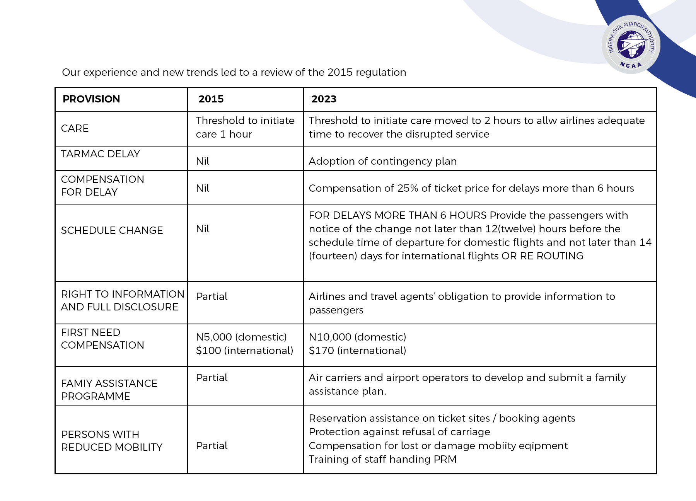

Slide 11
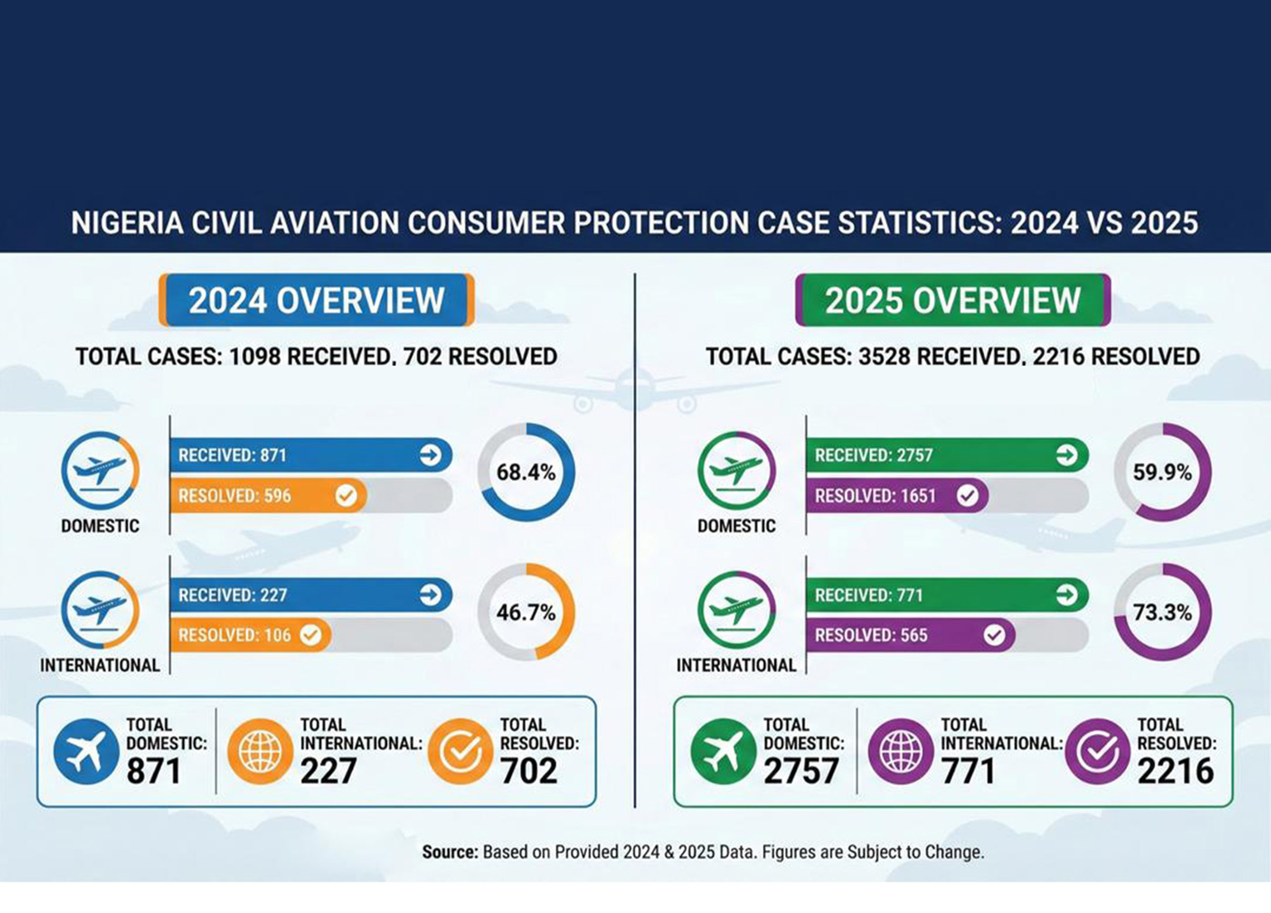

Slide 12

07 | International Standards & Global Benchmarks
Montreal Convention 1999 (MC99)
Nigeria is a party to MC99, which sets international liability limits for international carriage. MC99 governs compensation for death/injury, baggage loss/damage and flight delay on international routes — NIG. CARs Part 19 complements MC99 for domestic carriage and consumer rights not covered by the Convention.
ICAO Doc. 9626
EU Regulation 261/2004
AFCAC Framework
Manual on Regulation of International Air Transport
European passenger rights benchmark
African Civil Aviation Commission
Provides policy guidance on consumer protection approaches
Global gold standard: compensation up to €600 for long-haul cancellations
Continent-wide push for harmonised consumer protection standards
Recommends minimum standards for passenger rights regimes
NCAR Part 19 modelled on EU 261/2004 framework — adapted for Nigerian market
Nigeria's Part 19 among the most comprehensive frameworks in Africa
Nigeria's Part 19 aligned with ICAO consumer policy principles
Compensation thresholds in Naira equivalent; same right-to-care principles
SAATM commitments require adequate consumer protection infrastructure

Slide 13

08 | Ministerial Priorities & Way Forward
Priority 1
Priority 2
Full Operationalisation of NCAR Part 19 (2023)
Consumer Awareness & Rights Education
Direct NCAA to issue implementation circulars for all regulations within Part 19
Mandate the Launch nationwide 'Know Your Rights' passenger rights campaign by NCAA
Mandate all domestic and international airlines to display passenger rights notices at all Nigerian airport check-in counters within 90 days
Deploy consumer rights digital kiosks at all international and major domestic terminals
Mandate airline staff training on NIG CAR Part 19 passenger rights — NCAA-certified programme
Priority 3
Priority 4
Strengthen Enforcement Architecture
Compensation Fund & Financial Safeguards
real-time NCAA Consumer Protection Digital Complaint Portal with 48-hour acknowledgment SLA
Establish NCAA-administered Aviation Consumer Compensation Fund for insolvent carriers
Introduce annual Consumer Rights Compliance League Table — publicly naming top and bottom performers
Review compensation thresholds in Part 19 for annual adjustment in line with inflation

Slide 14
Conclusions & Recommendations
01
Nigeria’s NIG.CARs Part 19 (2023) is one of Africa's most comprehensive aviation consumer protection instruments — establishing legally enforceable rights for every passenger departing a Nigerian airport.
02
Full implementation of Part 19 requires sustained Ministerial and NCAA oversight: mandatory airline compliance, operational consumer desks at all airports, and a functional complaint resolution mechanism.
03
The compensation framework — covering denied boarding , cancellations, delays, baggage loss and PRM rights — must be communicated widely to ensure passengers know and exercise their rights.
04
NCAA's enforcement escalation ladder (warning → fine → suspension → revocation) provides robust deterrence; the Honourable Minister's support for timely prosecutions will drive airline compliance culture.
05
Priority actions: gazette the Aviation Consumer Protection Tribunal, launch the NCAA digital complaint portal, establish the consumer compensation fund, and publish the annual airline compliance league table.
Federal Ministry of Aviation & Aerospace Development · NCAA · NCAR Part 19 Consumer Protection Regulations 2023 · Federal Republic of Nigeria

Slide 15
